Slide 1

[SCHOOL NAME]
[Date]
COORDINATOR:
[Coordinator Name]

Slide 2


• Cereal
• Snacks
• Meals & sides
• Baking products
• Office supplies
• And more!

Slide 3


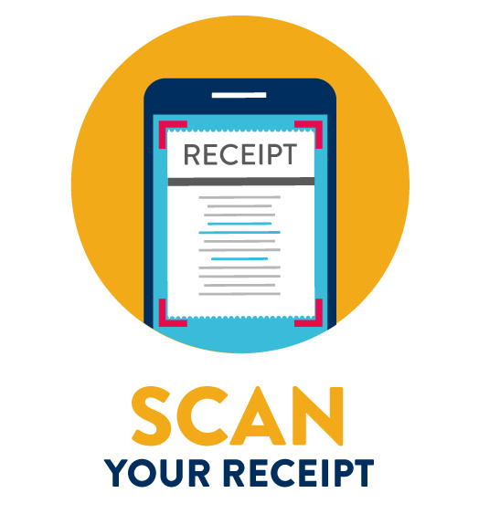


• Use the app to snap a photo of your store receipt within 14 days of purchase.
• The app scans your receipt, finds Box Tops products and instantly adds cash to our school earnings online.
• Our school can receive two checks every school year, one in December and one in April.
RECEIPT

Slide 4



Forward your email receipt to:
receipts@boxtops4education.com
using the same email that’s associated
with your Box Tops account.
Learn more at BTFE.com/emailgroceryreceipts
Box Tops clips have been phased out of production, but may still occasionally be found on products throughout the store.
• You can still clip these and send them to school.
• Please make sure each clip has a valid expiration date.
• Our school’s Box Tops Coordinator will submit these clips to Box Tops for Education
so they can be added to our earnings totals.

Slide 5

The cash we earn with Box Tops can be used to buy anything our school needs.

Slide 6

• DOWNLOAD the Box Tops app and select our school to support
This ensures that your Box Tops purchases count toward our school's earnings.
• SHOP for Box Tops products and use the app to scan your receipt to add to our school’s earnings online.
• LOOK for any remaining Box Tops clips on packages. If you find some, clip them and send them to school!
• VOLUNTEER to help our school's Coordinator, especially during clip submission periods (October & February).
• SPREAD THE WORD about Box Tops!
Box Tops offers pre-made flyers and images to use on social media.
You can also use the “Invite Friends” feature in the app to ask friends and family
to help support our school.

Slide 7
LAST YEAR’S EARNINGS:
$[TOTAL HERE]
THIS YEAR’S GOAL:
$[GOAL HERE]
WE’RE HOPING TO USE OUR BOX TOPS CASH TO FUND:
[Enter items here]

Slide 8


to download the Box Tops app
for more information
@boxtopsforeducation
@btfe

