Slide 1
Senior year prep
What you need to know going into senior year

Slide 2
TAKE ACT or SAT
The sooner the better
SAT is changing Spring 2016- don’t know as much about it at this time
SAT-June 2nd test (deadline to register is May 8th)
Register online at www.collegeboard.org
ACT-June 13th test (deadline to register is May 8th)
Register online at www.act.org
If you haven’t tested, plan to take the first available tests in the fall semester.
Remember—
4 year schools REQUIRE an SAT/ACT score for ADMISSION.
2 year schools do not.
However, some scholarships will want to see an SAT/ACT score.
Fee waivers available for students on free/reduced lunch.

Slide 3
SAT vs. ACT

Slide 4
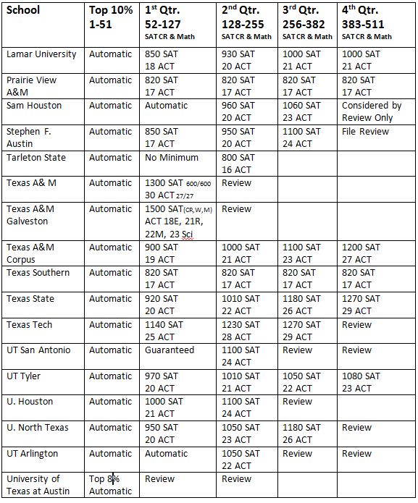
Acceptance criteria

Slide 5
TSI
Only required if planning to study in Texas
Determines placement (not admission)
Can be exempt with
ACT composite of 23 with a 19 in English and/or a 19 in Math
SAT score of 1070 with a 500 in Critical Reading and/or a 500 in Math
If you have taken dual credit in high school, you may also be exempt.

Slide 6
Apply Texas
Apply Texas is the common application for public schools in Texas.
Available online at www.applytexas.org
Opens August 1st
Create one application and copy
Does not include all private schools in Texas
Application fee waivers for students who used a fee waiver on SAT/ACT.

Slide 7
Common Application
www.commonapp.org/Login
Not for profit organization
Over 500 member schools
Must create an account
Application is more in-depth

Slide 8
Essay topics
Apply Texas essay topics:
Essay A:
Describe a setting in which you have collaborated or interacted with people whose experiences and/or beliefs differ from yours. Address your initial feelings, and how those feelings were or were not changed by this experience.
Essay B:
Describe a circumstance, obstacle or conflict in your life, and the skills and resources you used to resolve it. Did it change you? If so, how?
Essay C:
Considering your lifetime goals, discuss how your current and future academic and extra-curricular activities might help you achieve your goals.

Slide 9
Activity list/resume
Lists all activities both in and outside of school (9th-12th grade)
Clubs
Sports
Community service
Civic organizations
Employment
Summer camps
Awards/honors

Slide 10
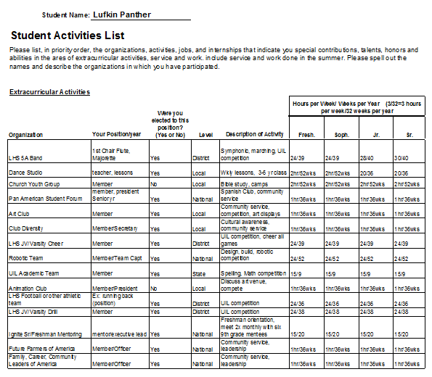

Slide 11
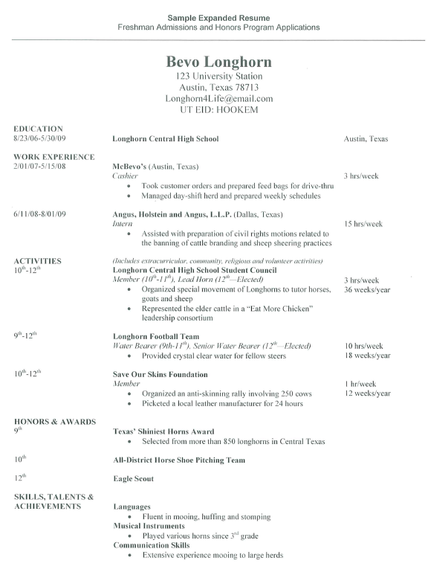

Slide 12
GPA & transcripts
Will be available August 1st
Notices on procedure will be mailed over the summer
Must send transcripts to schools you apply to
First 3 transcripts requested are free. Each additional transcript is $3.

Slide 13
$CHOLAR$HIP BA$IC$
What kinds of scholarships are available?
Who is eligible?
Where can I find scholarships?
Common mistakes
Steps for a strong scholarship application

Slide 14
KINDS OF $CHOLAR$HIP$
Institutional scholarships are awarded by higher education institutions. The amount awarded is often based on merit and need.
Contact your school for a listing of specific scholarships available.

Slide 15
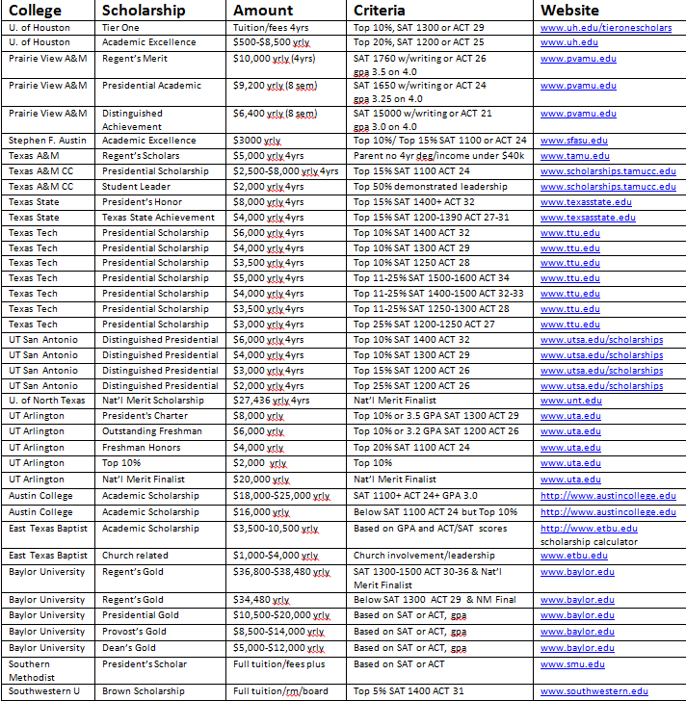
MERIT BASED $CHOLAR$HIP$

Slide 16
PRIVATE SECTOR $CHOLAR$HIP$
Private foundations, companies and service groups award scholarships.
Parents’ employers
Local civic organizations such as Rotary or Lion’s Club
Online scholarship search engines
Amount awarded varies
Scholarships can be payable to the student, the college, or both.

Slide 17
GENERAL $CHOLAR$HIP APPLICATION
ONE application for over 25 scholarships
Including the LHS Alumni Association Scholarship
Deadline is February
Requires
personal statement essay
activities list/resume
2 letters of recommendation
photo (head and shoulders)

Slide 18
WHERE CAN I FIND $CHOLAR$HIP$?

Slide 19
WHERE CAN I FIND $CHOLAR$HIP$ ?
www.fastweb.com
www.collegeforalltexans.com
www.zinch.com
http://www.everychanceeverytexan.org/about/scholars/
https://bigfuture.collegeboard.org/scholarship-search
Remind 101
Sign up for text and email alerts about incoming scholarship opportunities
Text- @lhs2016 to (509)774-5695
Email- lhs2016@mail.remind.com

Slide 20
COMMON $CHOLAR$HIP MISTAKES
Only applying for private scholarships
Applying for too few scholarships
Not following instructions
Other application mistakes
Not paying attention to deadlines
Looking for only a short time
Notes:
1-Most people think of scholarships as something offered by a private organization. Check locally and nationally for scholarships.
2-Getting lots of small scholarships adds up. Smaller scholarships are often less competitive, so you have better chances of winning an award.
3-Always double check your work, or even better, get someone else to look over your work. A second pair of eyes can help catch careless mistakes.
4-Attention to detail. Be neat. Turn in supporting documents in the order they are requested.
5-Missing a deadline is the biggest mistake you can make. Pay close attention to time of day deadlines for online apps. Apply before the deadline hits.
5-Start your search as early as you can, which will allow you more time to complete applications and earn scholarship awards. Also, new scholarships open and close throughout the school year.

Slide 21
10 STEPS TO A STRONG $CHOLAR$HIP APPLICATION
Get organized
Have your photo taken
Draft a good resume
Request recommendations
Get your transcript
Write general essays early and then customize
Set up a simple email address
Track due dates
Submit your application exactly as requested
Make copies before submitting
Notes:
1-Expandable file or notebook to protect copies or printouts.
2-Simple head shot. Some scholarships require a photo.
3-Include all organizations, clubs, volunteer work, extra-curricular activities and awards/honors.
4-Get at least 3 from teachers, counselors, clergy or employers.
5-Keep copies available in case.
6-Goals, achievement, financial need
7-Represents you well, not odd or offbeat
8-Track them on a calendar (time of day)
9-Present in order asked for
10-Print copy for your records. Send with delivery confirmation if mailing.

Slide 22
FAFSA
Free Application for Federal Student Aid
Three types of financial aid offered
Grants (never have to repay)
Loans (must repay)
Work study
Opens Jan. 1st
Is based on your family’s income for 2015

Slide 23
Thank you!
Questions?
Remind 101
Text- @lhs2016 to (509)774-5695
Email- lhs2016@mail.remind.com
Gaby Murphy
gmurphy@lufkinisd.org
936-633-7592

